Slide 1
Chapter 2
Public-Key Cryptography
Asymmetric algorithms rely on one key for encryption and a different but related key for decryption.
These algorithms have the following important characteristic:
● It is computationally infeasible to determine the decryption key given only knowledge of the cryptographic algorithm and the encryption key.
In addition, some algorithms, such as RSA, also exhibit the following Characteristic:
● Either of the two related keys can be used for encryption, with the other used for decryption.

Slide 2
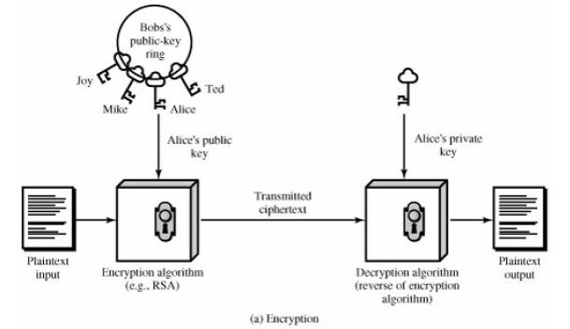
ENCRYPTION

Slide 3
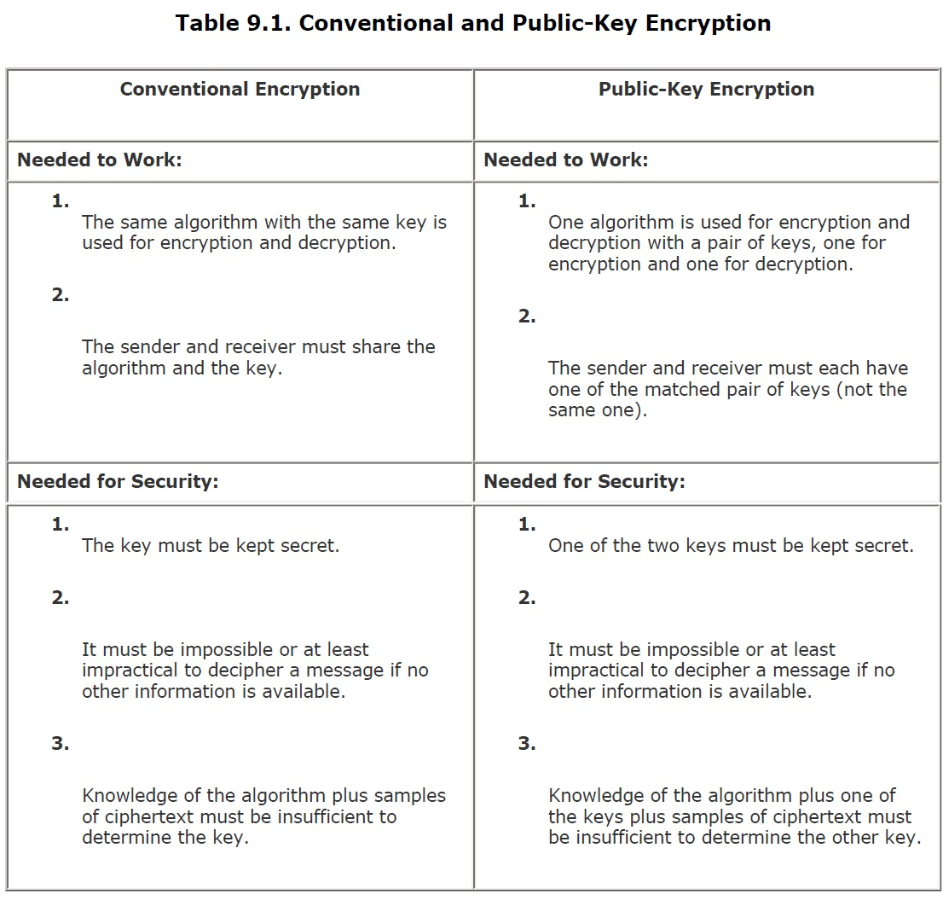

Slide 4
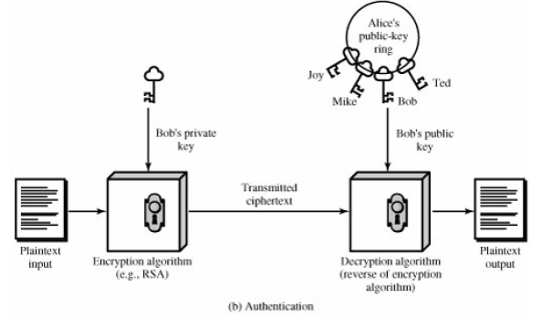
AUTHENTICATION

Slide 5
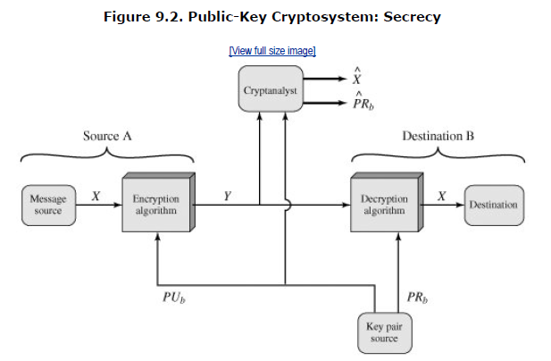

Slide 7
The RSA Algorithm
The pioneering paper by Diffie and Hellman [DIFF76b] introduced a new approach to cryptography and, in effect, challenged cryptologists to come up with a cryptographic algorithm that met the requirements for public-key systems.
One of the first of the responses to the challenge was developed in 1977 by Ron Rivest, Adi Shamir, and Len Adleman at MIT and first published in 1978.
The Rivest-Shamir-Adleman (RSA) scheme has since that time reigned supreme as the most widely accepted and implemented general-purpose approach to public-key encryption.

Slide 8
Description of the Algorithm
The scheme developed by Rivest, Shamir, and Adleman makes use of an expression with exponentials.
Plaintext is encrypted in blocks, with each block having a binary value less than some number n. That is, the block size must be less than or equal to log2(n); in practice, the block size is i bits, where 2i < n < 2i+1. Encryption and decryption are of the following form, for some plaintext block M and ciphertext block C:
Both sender and receiver must know the value of n. The sender knows the value of e, and only the receiver knows the value of d. Thus, this is a public-key encryption algorithm with a public key of PU = {e, n} and a private key of PU = {d, n}.

Slide 9
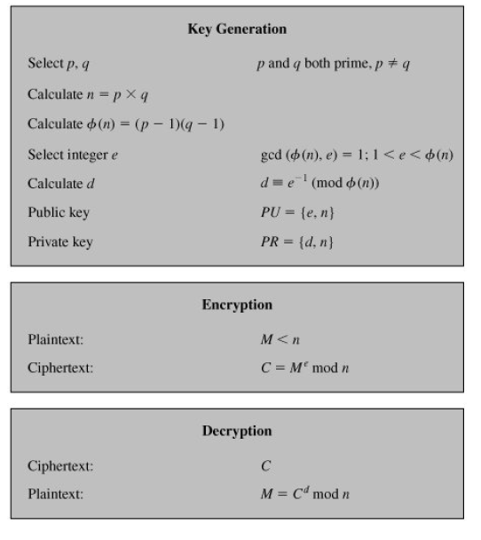

Slide 10
Figure 9.5 summarizes the RSA algorithm. An example, from [SING99], is shown in Figure 9.6. For this example, the keys were generated as follows:
Select two prime numbers, p = 17 and q = 11.
Calculate n = pq = 17 x 11 = 187.
Calculate φ(n) = (p - 1)(q - 1) = 16 x 10 = 160.
Select e such that e is relatively prime to φ(n) = 160 and less than φ(n) we choose e = 7.
Determine d such that
The correct value is d = 23, because 23 x 7 = 161 = 10 x 160 + 1; d can be calculated using the extended Euclid's algorithm

Slide 11
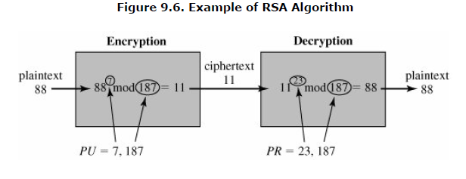

Slide 12
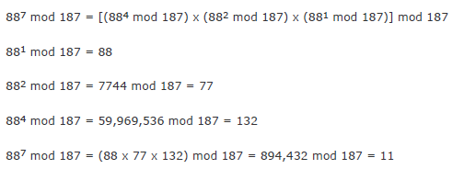

Slide 13
Diffie-Hellman Key Exchange
The first published public-key algorithm appeared in the seminal paper by Diffie and Hellman that defined public-key cryptography [DIFF76b] and is generally referred to as Diffie-Hellman key exchange. A number of commercial products employ this key exchange technique.
The purpose of the algorithm is to enable two users to securely exchange a key that can then be used for subsequent encryption of messages. The algorithm itself is limited to the exchange of secret values.

Slide 15
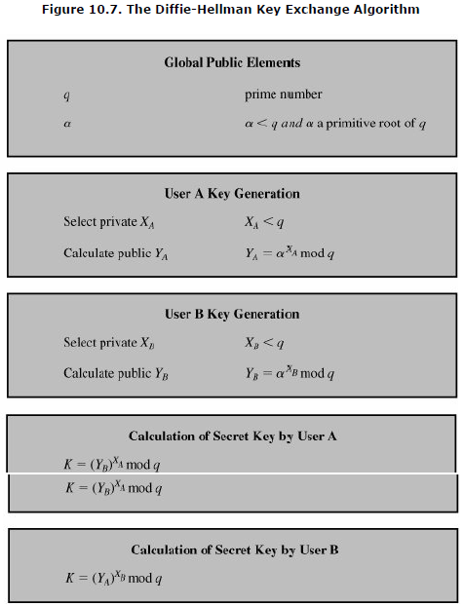

Slide 16
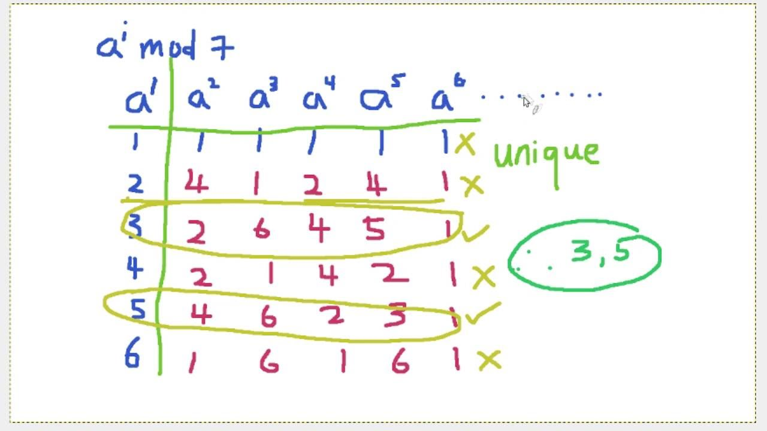
Primitive Root

Slide 17
Here is an example. Key exchange is based on the use of the prime number q = 353 and a primitive root of 353, in this case α = 3.
A and B select secret keys XA = 97 and XB = 233, respectively. Each computes its public key:
After they exchange public keys, each can compute the common secret key:

Slide 18
We assume an attacker would have available the following information:
In this simple example, it would be possible by brute force to determine the secret key 160.
In particular, an attacker E can determine the common key by discovering a solution to the equation $3^{a}$ mod 353=40
or the equation
The brute-force approach is to calculate powers of 3 modulo 353, stopping when the result equals either 40 or 248. The desired answer is reached with the exponent value of 97, which provides

