Slide 1
Authentication and Hash Function

Slide 2
HMAC HASH-BASED MESSAGE AUTHENTICATION CODE (OR) KEYED-HASH MESSAGE AUTHENTICATION CODE
The motivations for this interest are
Cryptographic hash functions such as MD5 and SHA-1 generally execute faster in software than symmetric block ciphers such as DES.
Library code for cryptographic hash functions is widely available.

Slide 3
A hash function such as SHA was not designed for use as a MAC and cannot be used directly for that purpose because it does not rely on a secret key.
There have been a number of proposals for the incorporation of a secret key into an existing hash algorithm. The approach that has received the most support is HMAC
HMAC has been chosen as the mandatory-to-implement MAC for IP security, and is used in other Internet protocols, such as SSL.

Slide 4
HMAC Design Objectives
HMAC treats the hash function as a "black box." This has two benefits. First, an existing implementation of a hash function can be used as a module in implementing HMAC. In this way, the bulk of the HMAC code is prepackaged and ready to use without modification.
Second, the security of HMAC could be retained simply by replacing the embedded hash function with a more secure one
HMAC can be proven secure provided that the embedded hash function has some reasonable cryptographic strengths

Slide 9
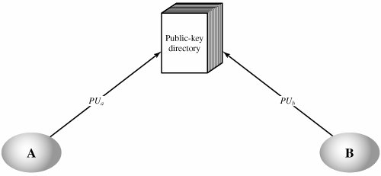
Public Announcement of Public Keys
Publicly Available Directory

Slide 10
Public-Key Distribution Scenario

Slide 11
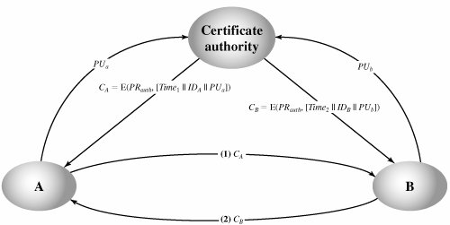
Public-Key Certificates

Slide 12
Simple Secret Key Distribution
Simple Use of Public-Key Encryption to Establish a Session Key

Slide 13
Message authentication
Message authentication is a mechanism or service used to verify the integrity of a message. Message authentication assures that data received are exactly as sent by (i.e., contain no modification, insertion, deletion, or replay) and that the purported identity of the sender is valid.
The two most common cryptographic techniques for message authentication are a message authentication code (MAC) and a secure hash function.
A MAC is an algorithm that requires the use of a secret key. A MAC takes a variable length message and a secret key as input and produces an authentication code. A recipient in possession of the secret key can generate an authentication code to verify the integrity of the message.
A hash function maps a variable-length message into a fixed length hash value, or message digest. A function that maps a message of any length into a fixed-length hash value, which serves as the authenticator

Slide 14
Authentication Requirements
1.Disclosure
2.Traffic analysis
3.Masquerade
4.Content modification
5.Sequence modification
6.Timing modification
7.Source repudiation
8.Destination repudiation

Slide 15
Authentication Functions
Message encryption: The ciphertext of the entire message serves as its authenticator
Message authentication code (MAC): A function of the message and a secret key that produces a fixed-length value that serves as the authenticator
Hash function: A function that maps a message of any length into a fixed-length hash value, which serves as the authenticator

Slide 16
Message encryption

Slide 17
Message authentication code (MAC):
MAC = C(K,M)
where
M = input message
C = MAC function
K = shared secret key
MAC = message authentication code

Slide 18
The message plus MAC are transmitted to the intended recipient. The recipient performs the same calculation on the received message, using the same secret key, to generate a new MAC. The received MAC is compared to the calculated MAC (Figure 11.4a). If we assume that only the receiver and the sender know the identity of the secret key, and if the received MAC matches the calculated MAC, then
1. The receiver is assured that the message has not been altered. If an attacker alters the message but does not alter the MAC, then the receiver's calculation of the MAC will differ from the received MAC. Because the attacker is assumed not to know the secret key, the attacker cannot alter the MAC to correspond to the alterations in the message.
2. The receiver is assured that the message is from the alleged sender. Because no one else knows the secret key, no one else could prepare a message with a proper MAC.
3. If the message includes a sequence number (such as is used with HDLC, X.25, and TCP), then the receiver can be assured of the proper sequence because an attacker cannot successfully alter the sequence number.

Slide 20
Message Authentication Code Based on DES
The Data Authentication Algorithm, based on DES, has been one of the most widely used MACs for a number of years.
The algorithm can be defined as using the cipher block chaining (CBC) mode of operation of DES (Figure 6.4) with an initialization vector of zero.

Slide 21
O1 = E(K, D1)
O2 = E(K, [D2 O1])
O3 = (K, [D3 O2])
•
•
•
ON = E(K, [DN ON1])

Slide 22
Hash Function
A variation on the message authentication code is the one-way hash function.
As with the message authentication code, a hash function accepts a variable-size message M as input and produces a fixedsize output, referred to as a hash code H(M).
Unlike a MAC, a hash code does not use a key but is a function only of the input message.
The hash code is also referred to as a message digest or hash value.
The hash code is a function of all the bits of the message and provides an error-detection capability
A change to any bit or bits in the message results in a change to the hash code.

Slide 23
Figure 11.5 illustrates a variety of ways in which a hash code can be used to provide message authentication, as follows:

Slide 25
Requirements for a Hash Function
H can be applied to a block of data of any size.
2. H produces a fixed-length output.
3. H(x) is relatively easy to compute for any given x, making both hardware and software implementations practical.
4. For any given value h, it is computationally infeasible to find x such that H(x) = h. This is sometimes referred to in the literature as the one-way property.
5. For any given block x, it is computationally infeasible to find y ≠ x such that H(y) = H(x). This is sometimes referred to as weak collision resistance.
6. It is computationally infeasible to find any pair (x, y) such that H(x) = H(y). This is sometimes referred to as strong collision resistance.

Slide 26
Simple Hash Functions

Slide 27
Secure Hash Algorithm

Slide 29
SHA-512 Processing of a Single 1024-Bit Block

Slide 30
