Slide 1
NETWORK SECURITY AND FIREWALL

Slide 2
INTERNET CONNECTIVITY IS NO LONGER OPTIONAL FOR ORGANIZATIONS.

Slide 3
FIREWALL
A firewall forms a barrier through which the traffic going in each direction must pass. A firewall security policy dictates which traffic is authorized to pass in each direction.
A firewall may be designed to operate as a filter at the level of IP packets, or may operate at a higher protocol layer

Slide 4
Firewall Design Principles
Firewall Characteristics
1. All traffic from inside to outside, and vice versa, must pass through the firewall. This is achieved by physically blocking all access to the local network except via the firewall. Various configurations are possible, as explained later in this section.
2. Only authorized traffic, as defined by the local security policy, will be allowed to pass. Various types of firewalls are used, which implement various types of security policies
3. The firewall itself is immune to penetration. This implies that use of a trusted system with a secure operating system.

Slide 5
capabilities are within the scope of a firewall
A firewall defines a single choke point that keeps unauthorized users out of the protected network, prohibits potentially vulnerable services from entering or leaving the network, and provides protection from various kinds of IP spoofing and routing attacks.
A firewall provides a location for monitoring security-related events. Audits and alarms can be implemented on the firewall system.
A firewall is a convenient platform for several Internet functions that are not security related. These include a network address translator, which maps local addresses to Internet addresses, and a network management function that audits or logs Internet usage.
A firewall can serve as the platform for IPSec. Using the tunnel mode capability described in Chapter 16,

Slide 6
Firewalls have their limitations
1. The firewall cannot protect against attacks that bypass the firewall. Internal systems may have dial-out capability to connect to an ISP. An internal LAN may support a modem pool that provides dial-in capability for traveling employees and telecommuters.
2. The firewall does not protect against internal threats, such as a disgruntled employee or an employee who unwittingly cooperates with an external attacker.
3. The firewall cannot protect against the transfer of virus-infected programs or files. Because of the variety of operating systems and applications supported inside the perimeter, it would be impractical and perhaps impossible for the firewall to scan all incoming files, e-mail, and messages for viruses.

Slide 7
Types of Firewalls
Packet-Filtering Router
Application-Level Gateway
Circuit-Level Gateway

Slide 8
PACKET-FILTERING ROUTER
A packet-filtering router applies a set of rules to each incoming and outgoing IP packet and then forwards or discards the packet.
The router is typically configured to filter packets going in both directions (from and to the internal network).
Filtering rules are based on information contained in a network packet:
Source IP address
Destination IP address
Source and destination transport-level address: TCP or UDP port
IP protocol field
Interface : interface of the router the packet came from or to
If there is no match to any rule, then a default action is taken. Two default policies are possible: Default = discard: Default = forward:

Slide 9
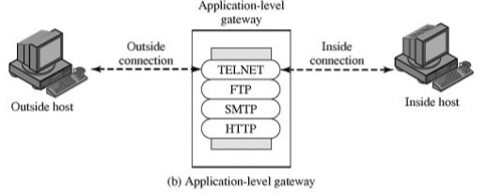
APPLICATION-LEVEL GATEWAY
An application-level gateway, also called a proxy server, acts as a relay of application-level traffic
The user contacts the gateway using a TCP/IP application, such as Telnet or FTP, and the gateway asks the user for the name of the remote host to be accessed. When the user responds and provides a valid user ID and authentication information, the gateway contacts the application on the remote host and relays TCP segments containing the application data between the two endpoints.
A prime disadvantage of this type of gateway is the additional processing overhead on each connection.

Slide 10
CIRCUIT-LEVEL GATEWAY
This can be a stand-alone system or it can be a specialized function performed by an application-level gateway for certain applications.
A circuit-level gateway does not permit an end-to-end TCP connection; rather, the gateway sets up two TCP connections, one between itself and a TCP user on an inner host and one between itself and a TCP user on an outside host.
Once the two connections are established, the gateway typically relays TCP segments from one connection to the other without examining the contents.
The security function consists of determining which connections will be allowed.

Slide 11
Electronic Mail Security
PGP - Pretty Good Privacy
S/MIME - Secure/Multipurpose Internet Mail Extension

Slide 12
PGP - Pretty Good Privacy
Largely the effort of a single person, Phil Zimmermann,
PGP provides a confidentiality and authentication service that can be used for electronic mail and file storage applications.

Slide 13
In essence, Zimmermann has done the following:
1. Selected the best available cryptographic algorithms as building blocks
2. Integrated these algorithms into a general-purpose application that is independent of operating system and processor and that is based on a small set of easy-to-use commands
3. Made the package and its documentation, including the source code, freely available via the Internet, bulletin boards, and commercial networks such as AOL (America On Line)
4. Entered into an agreement with a company (Viacrypt, now Network Associates) to provide a fully compatible, low-cost commercial version of PGP

Slide 15
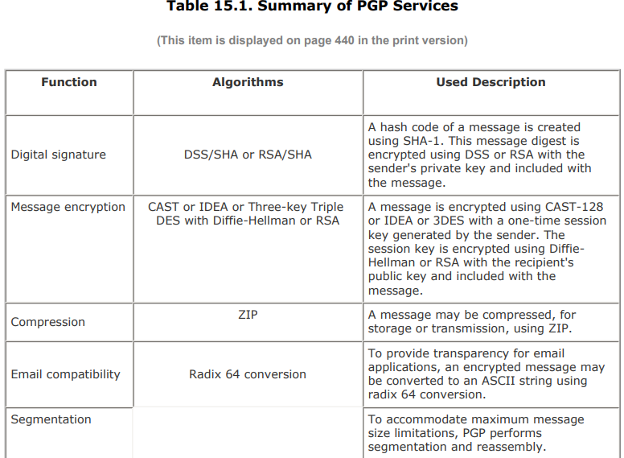

Slide 18
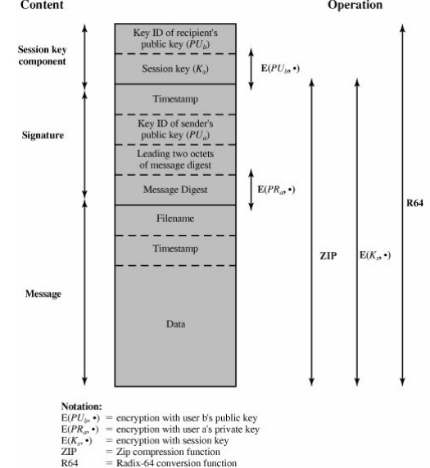
. General Format of PGP Message

Slide 20
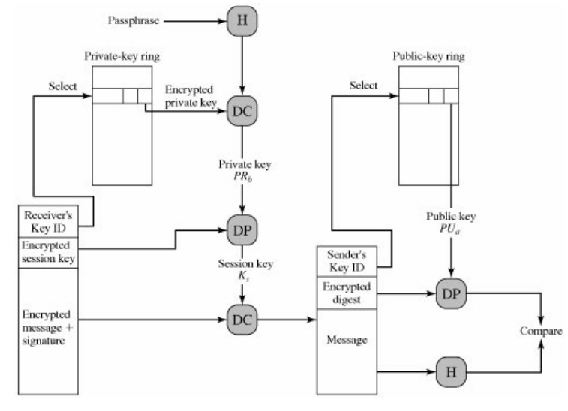
PGP Message Reception conversion)

Slide 21
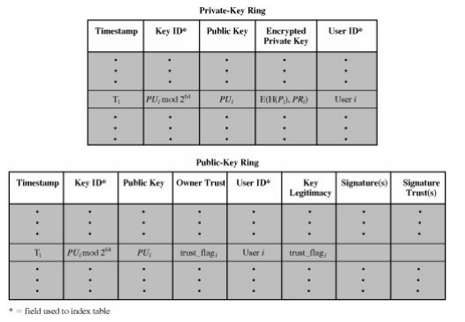

Slide 22
S/MIME
S/MIME (Secure/Multipurpose Internet Mail Extension) is a security enhancement to the MIME Internet email format standard, based on technology from RSA Data Security.
Although both PGP and S/MIME are on an IETF standards track, it appears likely that S/MIME will emerge as the industry standard for commercial and organizational use, while PGP will remain the choice for personal e-mail security for many users.

Slide 23
RFC 822
RFC 822 defines a format for text messages that are sent using electronic mail.
It has been the standard for Internet-based text mail message and remains in common use.
In the RFC 822 context, messages are viewed as having an envelope and contents. The envelope contains whatever information is needed to accomplish transmission and delivery

Slide 25
limitations of the SMTP/822 scheme:
SMTP cannot transmit executable files or other binary objects
SMTP cannot transmit text data that includes national language characters
SMTP servers may reject mail message over a certain size.
SMTP gateways that translate between ASCII and the character code EBCDIC do not use a consistent set of mappings, resulting in translation problems
SMTP gateways to X.400 electronic mail networks cannot handle nontextual data
Some SMTP implementations do not adhere completely to the SMTP standards defined in RFC 821. C
Common problems include:
❍ Deletion, addition, or reordering of carriage return and linefeed ❍ Truncating or wrapping lines longer than 76 characte

Slide 26
S/MIME Functionality
Enveloped data: This consists of encrypted content of any type and encrypted-content encryption keys for one or more recipients.
Signed data: A digital signature is formed by taking the message digest of the content to be signed and then encrypting that with the private key of the signer. The content plus signature are then encoded using base64 encoding. A signed data message can only be viewed by a recipient with S/MIME capability.
Clear-signed data: As with signed data, a digital signature of the content is formed. However, in this case, only the digital signature is encoded using base64. As a result, recipients without S/ MIME capability can view the message content, although they cannot verify the signature.
Signed and enveloped data: Signed-only and encrypted-only entities may be nested, so that encrypted data may be signed and signed data or clear-signed data may be encrypted.

Slide 27
Kerberos
Kerberos is an authentication service.
The problem that Kerberos addresses is this:
Assume an open distributed environment in which users at workstations wish to access services on servers distributed throughout the network.
We would like for servers to be able to restrict access to authorized users and to be able to authenticate requests for service.
In this environment, a workstation cannot be trusted to identify its users correctly to network services.

Slide 28
In particular, the following three threats exist:
A user may gain access to a particular workstation and pretend to be another user operating from that workstation.
A user may alter the network address of a workstation so that the requests sent from the altered workstation appear to come from the impersonated workstation.
A user may eavesdrop on exchanges and use a replay attack to gain entrance to a server or to disrupt operations.

Slide 29
Motivation
Distributed architecture consisting of dedicated user workstations (clients) and distributed or centralized servers.
In this environment, three approaches to security can be envisioned:
1. Rely on each individual client workstation to assure the identity of its user or users and rely on each server to enforce a security policy based on user identification (ID).
2. Require that client systems authenticate themselves to servers, but trust the client system concerning the identity of its user.
3. Require the user to prove his or her identity for each service invoked. Also require that servers prove their identity to clients.
Kerberos supports this third approach. Kerberos assumes a distributed client/server architecture and employs one or more Kerberos servers to provide an authentication service.

Slide 30
Overview of Kerberos

Slide 31
A More Secure Authentication Dialogue

Slide 32
X.509 Authentication Service
X.509 is based on the use of public-key cryptography and digital signatures.
The standard does not dictate the use of a specific algorithm but recommends RSA.
The digital signature scheme is assumed to require the use of a hash function.

Slide 33
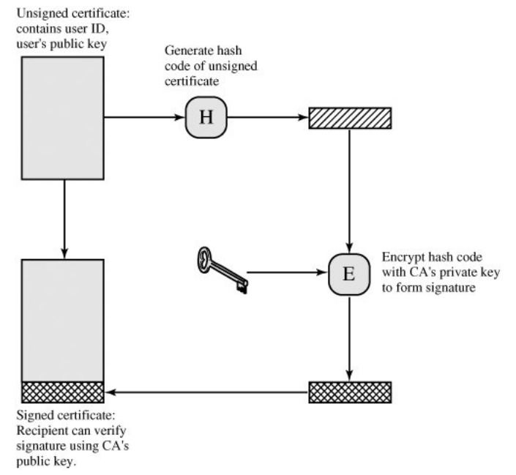
public-key certificate
The heart of the X.509 scheme is the public-key certificate associated with each user.

Slide 35
X.509 Strong Authentication Procedures

Slide 36
IP security (IPSec)
IP security (IPSec) is a capability that can be added to either current version of the Internet Protocol (IPv4 or IPv6), by means of additional headers.
IPSec encompasses three functional areas: authentication, confidentiality, and key management.
Authentication makes use of the HMAC message authentication code. Authentication can be applied to the entire original IP packet (tunnel mode) or to all of the packet except for the IP header (transport mode).
Confidentiality is provided by an encryption format known as encapsulating security payload. Both tunnel and transport modes can be accommodated.
IPSec defines a number of techniques for key management.

Slide 37
An IP Security Scenario

Slide 38
Applications of IPSec
Secure branch office connectivity over the Internet
Secure remote access over the Internet
Establishing extranet and intranet connectivity with partners
Enhancing electronic commerce security

Slide 39
IP Security Architecture

Slide 40
IPSec Services

Slide 41
Transport and Tunnel Modes
Both AH and ESP support two modes of use: transport and tunnel mode.
Transport Mode: Transport mode provides protection primarily for upper-layer protocols. That is, transport mode protection extends to the payload of an IP packet.
Tunnel Mode: Tunnel mode provides Protection to the entire IP packet

Slide 42
Tunnel Mode and Transport Mode Functionality

Slide 43
Authentication Header

Slide 45
TRANSPORT MODE

Slide 46
TUNNEL MODE

Slide 47
Encapsulating Security Payload
IPSec ESP format

