Slide 1
HACKING

Slide 2
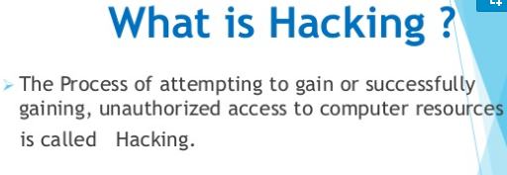

Slide 4
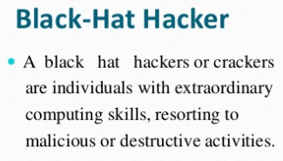
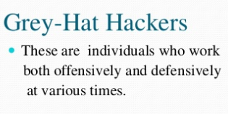

Slide 19
Countermeasures
Antivirus Approaches
Detection: Once the infection has occurred, determine that it has occurred and locate the virus.
Identification: Once detection has been achieved, identify the specific virus that has infected a program.
Removal: Once the specific virus has been identified, remove all traces of the virus from the infected program and restore it to its original state. Remove the virus from all infected systems so that the disease cannot spread further

Slide 20
Four generations of antivirus software:
● First generation: simple scanners - requires a virus signature to identify a virus (essentially the same structure and bit pattern in all copies)
● Second generation: heuristic scanners - a scanner may look for the beginning of an encryption loop used in a polymorphic virus and discover the encryption key. Once the key is discovered, the scanner can decrypt the virus to identify it, then remove the infection and return the program to service.
● Third generation: Identify a virus by its actions rather than its structure in an infected program
● Fourth generation: full-featured protection

Slide 21
Advanced Antivirus Techniques
Generic Decryption
Generic decryption (GD) technology enables the antivirus program to easily detect even the most complex polymorphic viruses, while maintaining fast scanning speeds
CPU emulator: : A software-based virtual computer. Instructions in an executable file are interpreted by the emulator rather than executed on the underlying processor. During interpretation, the target code can cause no damage to the actual personal computer environment, because it is being interpreted in a completely controlled environment.
Virus signature scanner - : A module that scans the target code looking for known virus signatures.
Emulation control module - :Controls the execution of the target code.

Slide 22
Digital Immune System

Slide 23
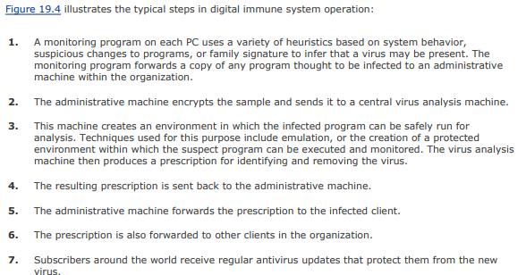

Slide 24
Behavior-Blocking Software
Monitored behaviors can include the following:
● Attempts to open, view, delete, and/or modify files;
● Attempts to format disk drives and other unrecoverable disk operations;
● Modifications to the logic of executable files or macros;
● Modification of critical system settings, such as start-up settings;
● Scripting of e-mail and instant messaging clients to send executable content;
● Initiation of network communications

