Slide 1
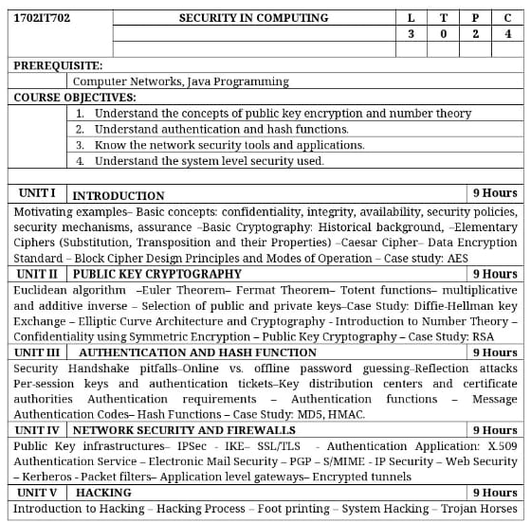

Slide 2
OUTCOMES: Upon Completion of the course, the students should be able to:
Compare various Cryptographic Techniques
Design Secure applications
Inject secure coding in the developed applications

Slide 3
Yours view on Security in Computing and Cyptography & Network Security
Example: Reason for most of the cyber attacks

Slide 4
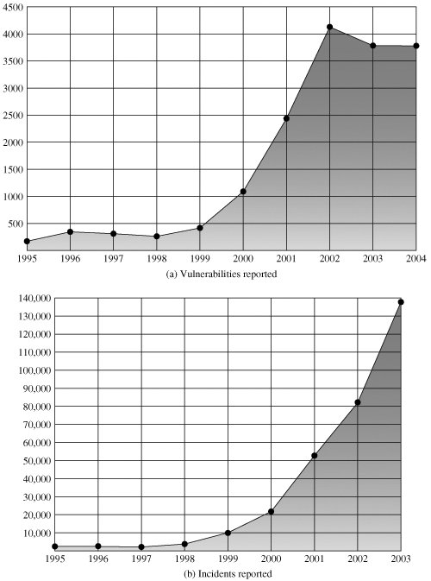
Security Trends

Slide 5
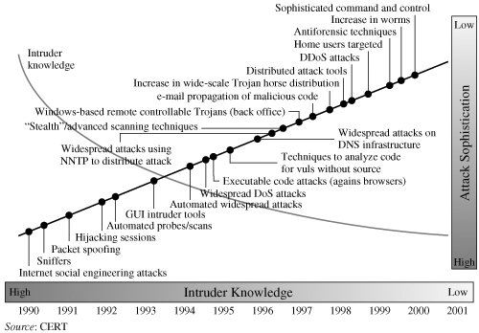

Slide 6
The OSI Security Architecture
SECURITY ATTACK:
Any action that compromises the security of information owned by an organization.
SECURITY MECHANISM:
A process (or a device incorporating such a process) that is designed to detect, prevent, or recover from a security attack.
SECURITY SERVICE:
A processing or communication service that enhances the security of the data processing systems and the information transfers of an organization. The services are intended to counter security attacks, and they make use of one or more security mechanisms to provide the service.
Example: Different sec in real world

Slide 7
Security Attacks
Passive attack attempts to learn or make use of information from the system but does not affect system resources.
Active attack attempts to alter system resources or affect their operation.

Slide 8
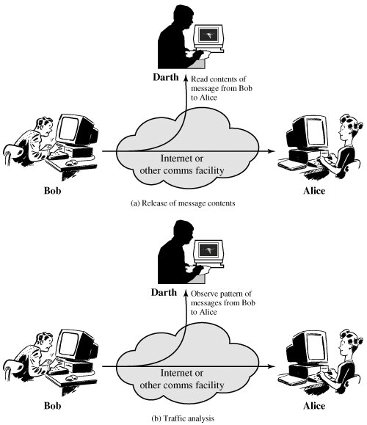
Passive Attacks

Slide 9
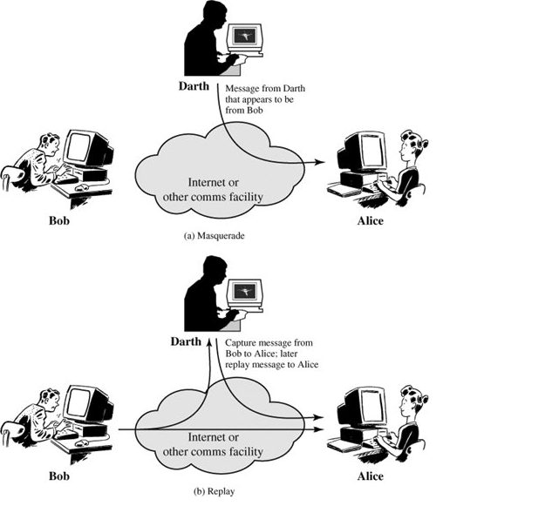
Active Attacks

Slide 10
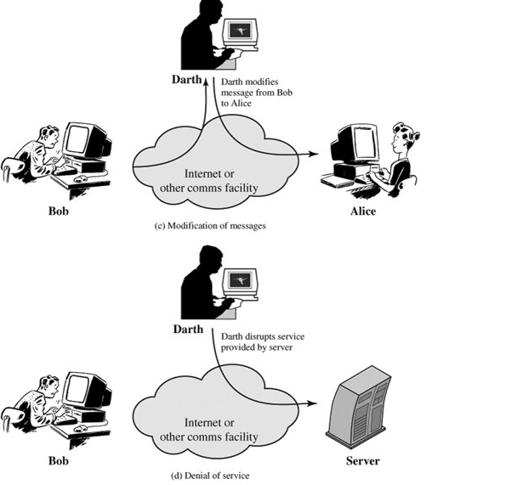

Slide 11
Security Services
AUTHENTICATION
ACCESS CONTROL
DATA CONFIDENTIALITY
DATA INTEGRITY
NONREPUDIATION

Slide 12
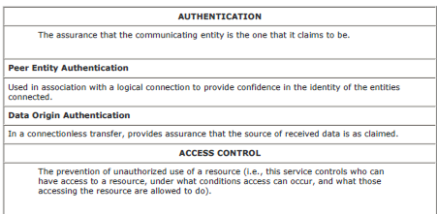

Slide 13
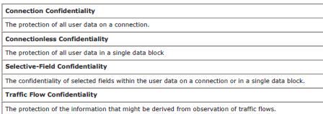

Slide 14
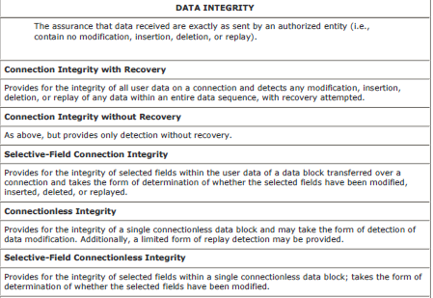

Slide 15
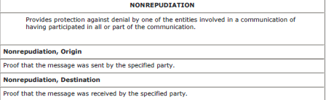

Slide 16
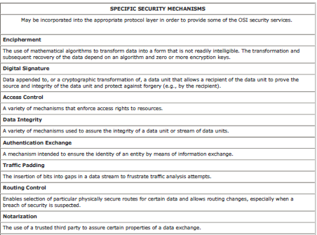
Security Mechanisms

Slide 17
Symmetric Cipher / Symmetric Encryption
Symmetric encryption is a form of cryptosystem in which encryption and decryption are performed using the same key.
transforms plaintext into ciphertext using a secret key and an encryption algorithm. Using the same key and a decryption algorithm, the plaintext is recovered from the ciphertext.
The two types of attack on an encryption algorithm are cryptanalysis, based on properties of the encryption algorithm, and brute-force, which involves trying all possible keys.

Slide 18
Symmetric Cipher Model
KEY FACTORS
  Plaintext
  Encryption algorithm
  Secret key
  Ciphertext
  Decryption algorithm

Slide 20
Classical Encryption Techniques
Substitution Techniques
  A substitution technique is one in which the letters of plaintext are replaced by other letters or by numbers or symbols.
Transposition Techniques
  different kind of mapping is achieved by performing some sort of permutation on the plaintext letters.

Slide 21
Substitution Techniques
A substitution technique is one in which the letters of plaintext are replaced by other letters or by numbers or symbols.
If the plaintext is viewed as a sequence of bits, then substitution involves replacing plaintext bit patterns with ciphertext bit patterns.
Types
Caesar Cipher
Monoalphabetic Ciphers
Playfair Cipher
Hill Cipher
Polyalphabetic Ciphers
One-Time Pad

Slide 22
Caesar Cipher
A shift may be of any amount, so that the general Caesar algorithm is
C = E(k, p) = (p + k) mod 26
where k takes on a value in the range 1 to 25.
The decryption algorithm is simply
p = D(k, C) = (C k) mod 26
If k=3,
plain: a b c d e f g h i j k l m n o p q r s t u v w x y z
cipher: D E F G H I J K L M N O P Q R S T U V W X Y Z A B C

Slide 23
Convert the plain text “ EGSPEC” using Caesar cipher
E – H here, C=E (4+3) mod 26 = 7

Slide 24
Monoalphabetic Ciphers

Slide 25
Playfair Cipher
The best-known multiple-letter encryption cipher is the Playfair, which treats the plaintext as single units and translates these units into ciphertext
diagrams.

Slide 26
Plaintext is encrypted two letters at a time, according to the following rules:
1. Repeating plaintext letters that are in the same pair are separated with a filler letter, such as x, so that balloon would be treated as ba lx lo on.
2. Two plaintext letters that fall in the same row of the matrix are each replaced by the letter to the right, with the first element of the row circularly following the last. For example, ar is encrypted as RM.
3. Two plaintext letters that fall in the same column are each replaced by the letter beneath, with the top element of the column circularly following the last. For example, mu is encrypted as CM.
4. Otherwise, each plaintext letter in a pair is replaced by the letter that lies in its own row and the column occupied by the other plaintext letter. Thus, hs becomes BP and ea becomes IM (or JM, as the encipherer wishes).

Slide 27
Hill Cipher
Developed by the mathematician Lester Hill in 1929
The encryption algorithm takes m successive plaintext letters and substitutes for them m ciphertext letters
The substitution is determined by m linear equations in which each character is assigned a numerical value (a = 0, b = 1 ... z = 25).
For m = 3, the system can be described as follows:
c1 = (k11P1 + k12P2 + k13P3) mod 26
c2 = (k21P1 + k22P2 + k23P3) mod 26
c3 = (k31P1 + k32P2 + k33P3) mod 26
This can be expressed in term of column vectors and matrices:
C = E(K, P) = KP mod 26

Slide 28
For example, consider the plaintext "pay" and use the encryption key
The first three letters of the plaintext are represented by the vector
the ciphertext for the entire plaintext is LNS

Slide 29
Decryption

Slide 30
Polyalphabetic Ciphers
Vigenère Cipher
Plain Text = I n d i
Key = c a r d
Cipher Text = k n u l

Slide 31
One-Time Pad
Each new message requires a new key of the same length as the new message. Such a scheme, known as a one-time pad, is unbreakable.
It produces random output that bears no statistical relationship to the plaintext.
Because the ciphertext contains no information whatsoever about the plaintext, there is simply no way to break the code.

Slide 32
Block Cipher vs Stream Cipher
Stream Cipher Converts the plain text into cipher text by taking 1 byte of plain text at a time. Example: Caeser cipher, Mono-alphabetical cipher
Block Cipher Converts the plain text into cipher text by taking plain text's block at a time. Example DES, AES

Slide 33
Data Encryption Standard
The most widely used encryption scheme is based on the Data Encryption Standard (DES) adopted in 1977 by the National Bureau of Standards.
For DES, data are encrypted in 64-bit blocks using a 56-bit key. The algorithm transforms 64-bit input in a series of steps into a 64-bit output. The same steps,with the same key, are used to reverse the encryption.

Slide 34
In the late 1960s, IBM set up a research project in computer cryptography led by Horst Feistel.
project concluded in 1971 with the development of an algorithm with the designation LUCIFER
sold to Lloyd's of London for use in a cash-dispensing system, also developed by IBM
LUCIFER is a Feistel block cipher that operates on blocks of 64 bits, using a key size of 128 bits
Because of the promising results produced by the LUCIFER project, IBM develop a marketable commercial encryption product that ideally could be implemented on a single chip

Slide 35
The effort was headed by Walter Tuchman and Carl Meyer, and it involved not only IBM researchers but also outside consultants and technical advice from NSA
The outcome of this effort was a refined version of LUCIFER that was more resistant to cryptanalysis but that had a reduced key size of 56 bits, to fit on a single chip.
In 1973, the National Bureau of Standards (NBS) issued a request for proposals for a national cipher standard.
IBM submitted the results of its Tuchman-Meyer project. This was by far the best algorithm proposed and was adopted in 1977 as the Data Encryption Standard

Slide 36
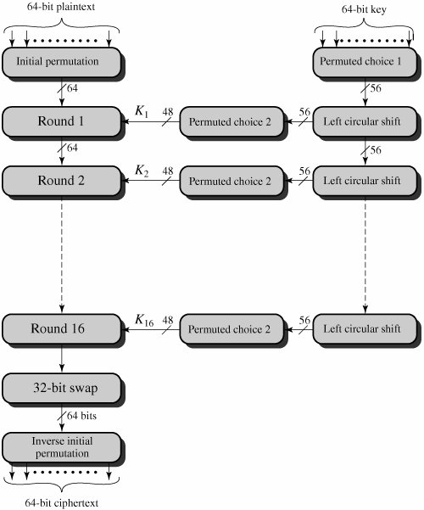
DES Encryption

Slide 37
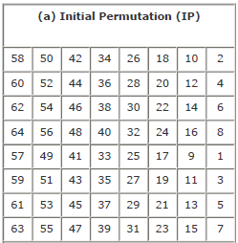

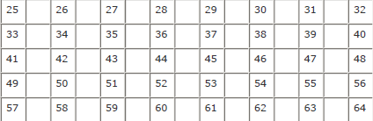
Initial Permutation
Input

Slide 38
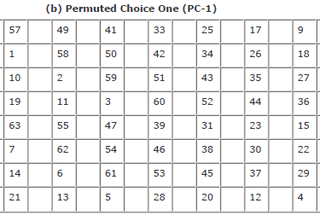
Permuted Choice 1

Slide 39

Left Circular Shift

Slide 40
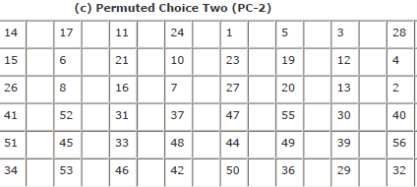
Permuted Choice 2

Slide 41
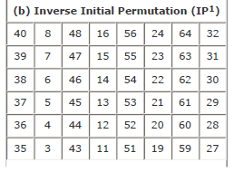


Slide 42
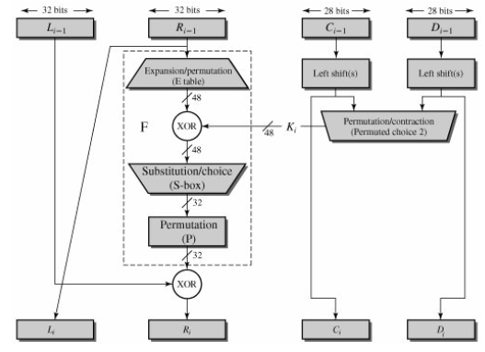
Single Round of DES Algorithm

Slide 43
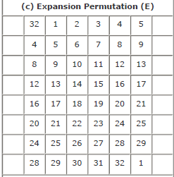

Slide 44
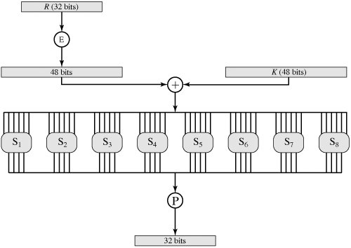
Definition of DES S-Boxes

Slide 45
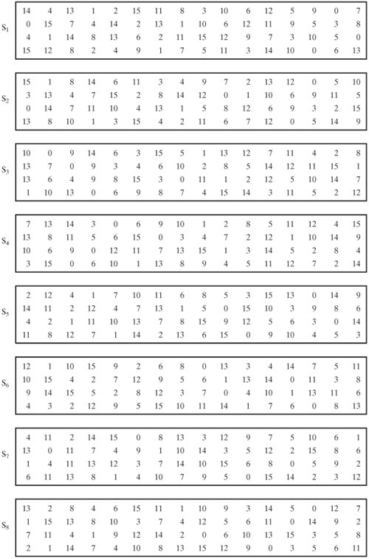
Definition of DES S-Boxes
For example,
in S1 for input 011001,
The row is 01 (row 1) and
the column is 1100 (column 12).
The value in row 1, column 12 is 9,
so the output is 1001.
ie. The binary value of nine.

Slide 46
The Avalanche Effect
A desirable property of any encryption algorithm is that a small change in either the plaintext or the key should produce a significant change in the ciphertext. In particular, a change in one bit of the plaintext or one bit of the key should produce a change in many bits of the ciphertext.

Slide 47
Block Cipher Modes of Operation
A block cipher algorithm is a basic building block for providing data security
In essence, a mode of operation is a technique for enhancing the effect of a cryptographic algorithm or adapting the algorithm for an application, such as applying a block cipher to a sequence of data blocks or a data stream

Slide 48
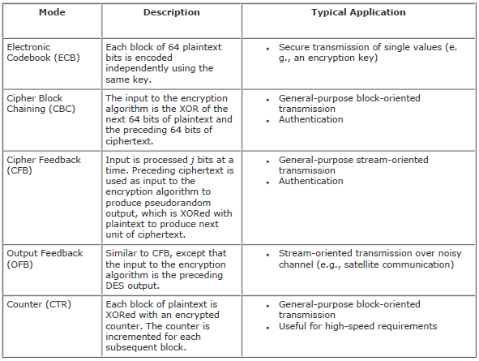

Slide 49
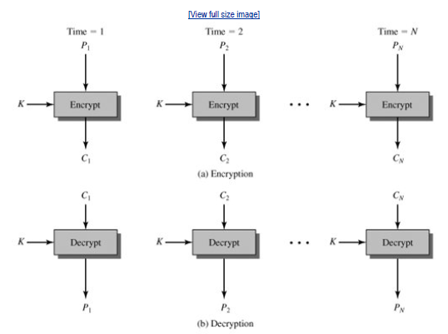
Electronic Codebook Mode
C1=E(K,P1)
P1=D(K,C1)

Slide 50
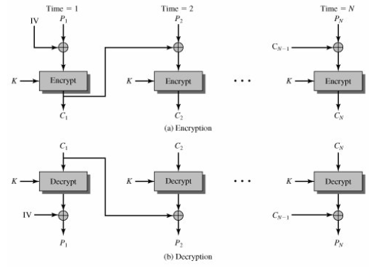

Cipher Block Chaining Mode

Slide 51
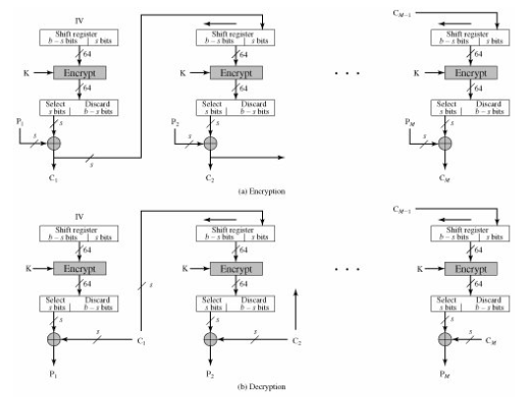
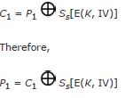
Cipher Feedback Mode

Slide 52
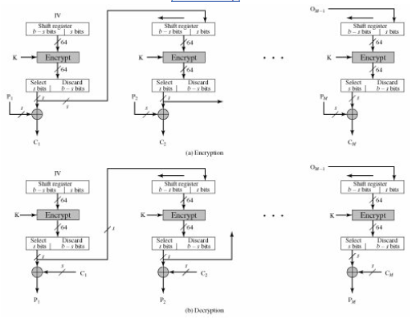
Output Feedback Mode

Slide 53
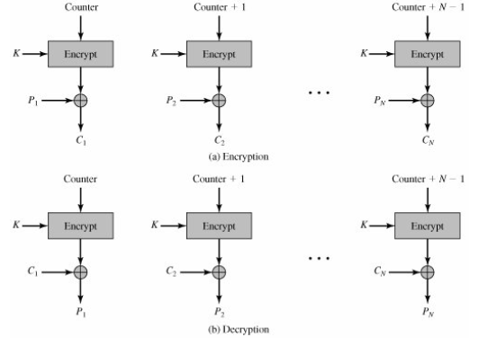
Counter Mode

Slide 54
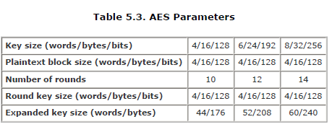
AES Cipher
The Rijndael proposal for AES defined a cipher in which the block length and the key length can be independently specified to be 128, 192, or 256 bits

Slide 55
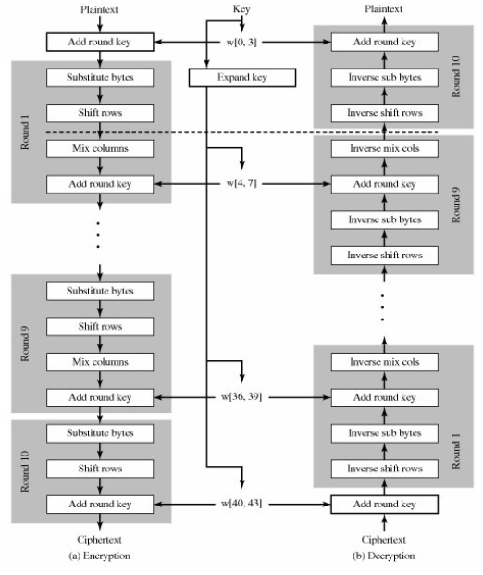

Slide 56
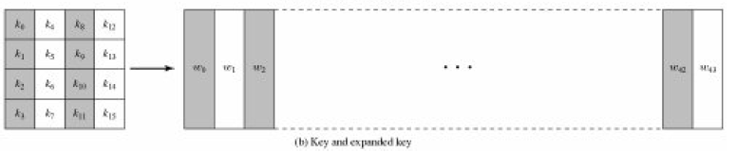
Key Expansion

Slide 57
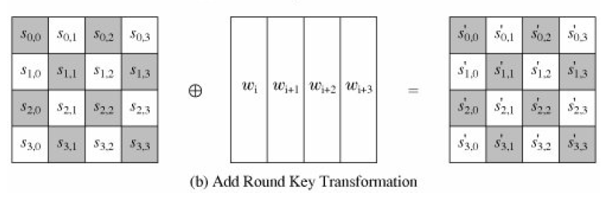
Add Round Key Transformation

Slide 58
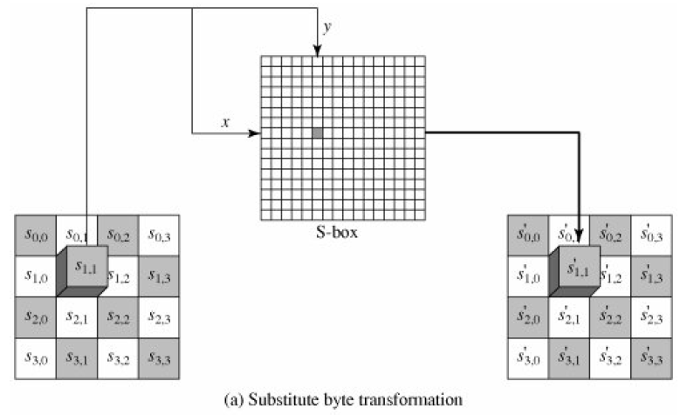
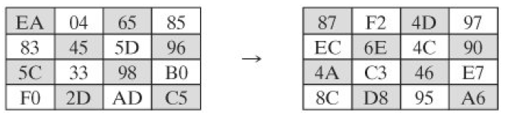
Substitute Bytes Transformation

Slide 59
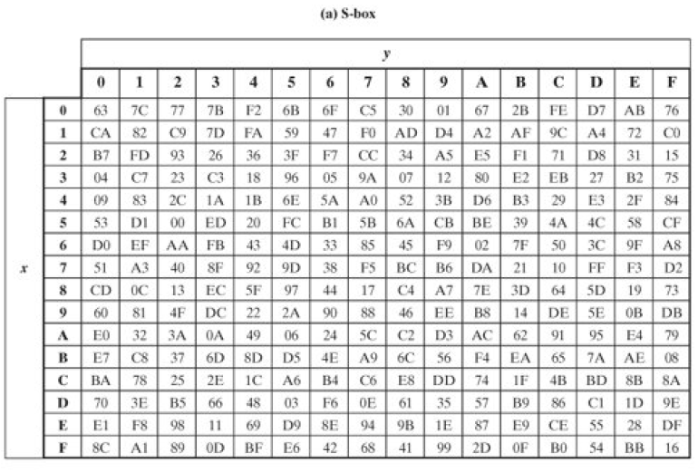

Slide 60
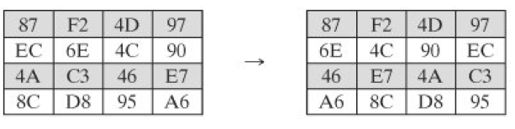
Shift Rows Transformation
The forward shift row transformation, called Shift Rows, is depicted in Figure.
The first row of State is not altered.
For the second row, a 1-byte circular left shift is performed.
For the third row, a 2-byte circular left shift is performed.
For the fourth row, a 3-byte circular left shift is performed.
The following is an example of Shift Rows

Slide 61
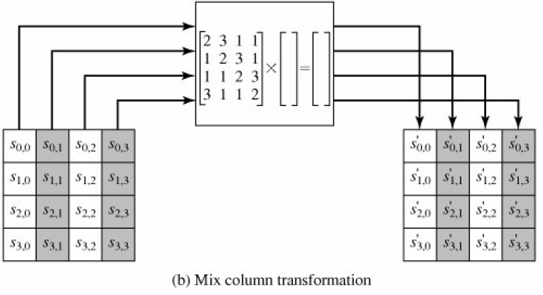
MixColumns Transformation

Slide 62

